Slide 1
360DigiTMG Database Project
The Importance of Using SQL and RDBMS

Slide 2
Agenda
01
Project Time Line
02
Project Objectives
03
What and Why Use RDBMS and SQL
04
Project ERD Design and Codes

Slide 3
Project Time Line
Schema Design
Show the
Scheme diagram and entity
relationship with all relevant
fields
Proof of Concept
Live database ready to showcase to the client
27 July 2020
30 July 2020
04 August 2020
07 August 2020
Finished Project
Database
Final Database
Need to
understand the business
requirements and decide
which database to be used
Actual
database inside the server
including all the tables and
the data

Slide 4
Project Objectives
Project Goal
Project Goal
Creating a database for organizing and storing data received through web application with student data and for fetching the most recent data from database.
The data stored in the DB must be organized and maintained in such a way it cater to the needs of the future. Derive insights from the results to device better strategies and enhance students’ performance from the past data.
Prepare a database that will cater future plans for Big Data and Data Analytics for improving students performance.
The schema must provide a solution for advanced AI and ML Applications.
Objectives
Goals
Identify and propose which type of database to be used SQL or NoSQL.
Provide business justification for the solution you are giving.
Crate an efficient solution for storing data and managing it for future requirements.
To design and build a database schema for business requirements.

Slide 5
Relational Database Management System is a type of Database management which focuses on the relational model. A relational database allows us to deal with different types of data in different ways. The data can retrieve and organize in many different ways with the advantage that the data won’t alter in the database. Data can access using an API called SQL.

Slide 6
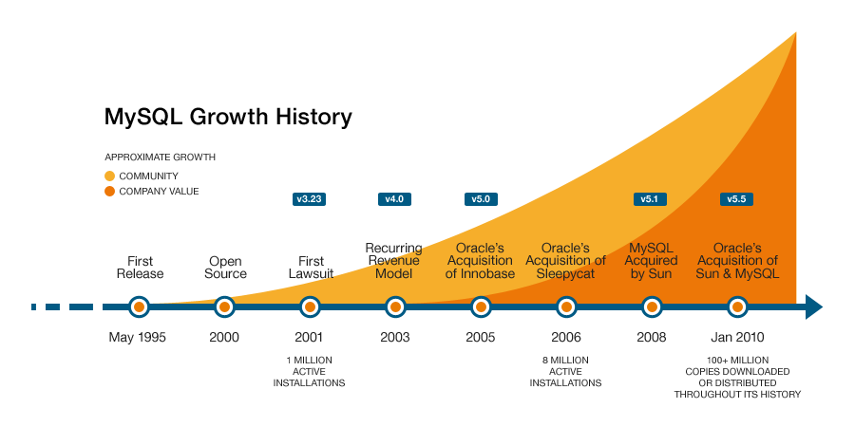

It is widely used in the Business Intelligence tool.
Data Manipulation and data testing are done through SQL.
Data Science tools depend highly on SQL. Big data tools such as Spark, Impala are dependent on SQL.
SQL is been long in the market resulting to have a lot of supports from developers, and community.
Due to documentation and long establishment over years, it provides a uniform platform worldwide to all its users.

Slide 7
Offers info to save within the tables.
Various users will access it along that manages by one user.
Virtual tables offer for storing the perceptive information.
So as to solely determine the rows, we use the first key.
We continuously save the information continuously in rows and columns.
To retrieve the information, we use indexes.

Slide 8
Advantages of RDBMS
Higher safety measures
Data just hold on once thus multiple documentation changes don’t seem to need.
RDBMSs allow various info users to admittance a info at the same time.
RDBMS comply with the database manager to limit admission to certified users, and gift rights to entity users depending on the sorts of database work they are doing
RDBMSs provide admission to the info via a server daemon, an ardent computer code program that responds to needs on a collection of connections and permits info users to attach and create use of the database.
You can simply impress your audience and add a unique zing and appeal to your Presentations.
The table arrangement is simple and easy for info users to understand and use.

Slide 9
Advantages of SQL :
Faster Query Processing
Portable
Large amount of data is retrieved quickly and efficiently. Operations like Insertion, deletion, manipulation of data is also done in almost no time.
It can be used in programs in PCs, server, laptops independent of any platform (Operating System, etc.). Also, it can be embedded with other applications as per need/requirement/use.
Easy Coding Skills
Standardized Language –
For data retrieval, large number of lines of code is not required. All basic keywords such as SELECT, INSERT INTO, UPDATE, etc are used and also the syntactical rules are not complex in SQL, which makes it a user-friendly language.
Easy to learn and understand, answers to complex queries can be received in seconds.

Slide 10
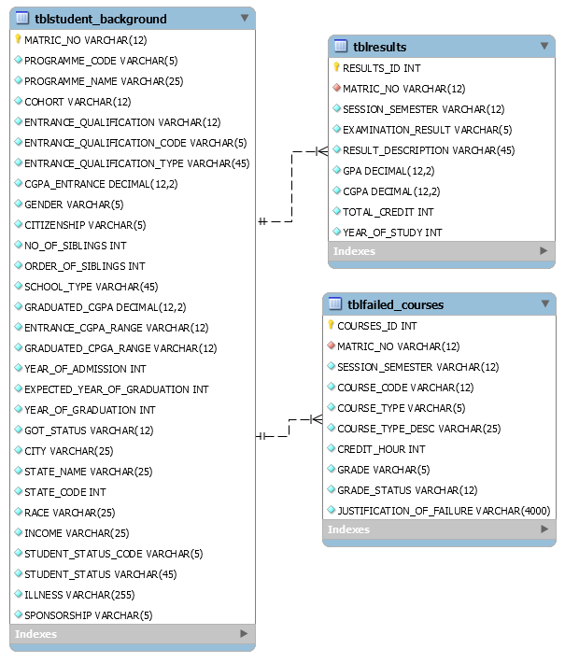
ERR Diagram
To Run the Code do the Following:
Install MySQL Server and Workbench.
Open the MySQL Scripts.
Execute the MySQL Scripts.

Slide 11
THANK YOU

